Slide 1

UNSUPERVISED CLUSTERING AFFINITY PROPAGATION

Slide 2
AFFINITY PROPAGATION

Slide 3

AFFINITY

Slide 4

PROPAGATION

Slide 5
AFFINITY PROPAGATION
Number of Clusters
Message Passing Clusters
Similarity Data Clusters

Slide 6
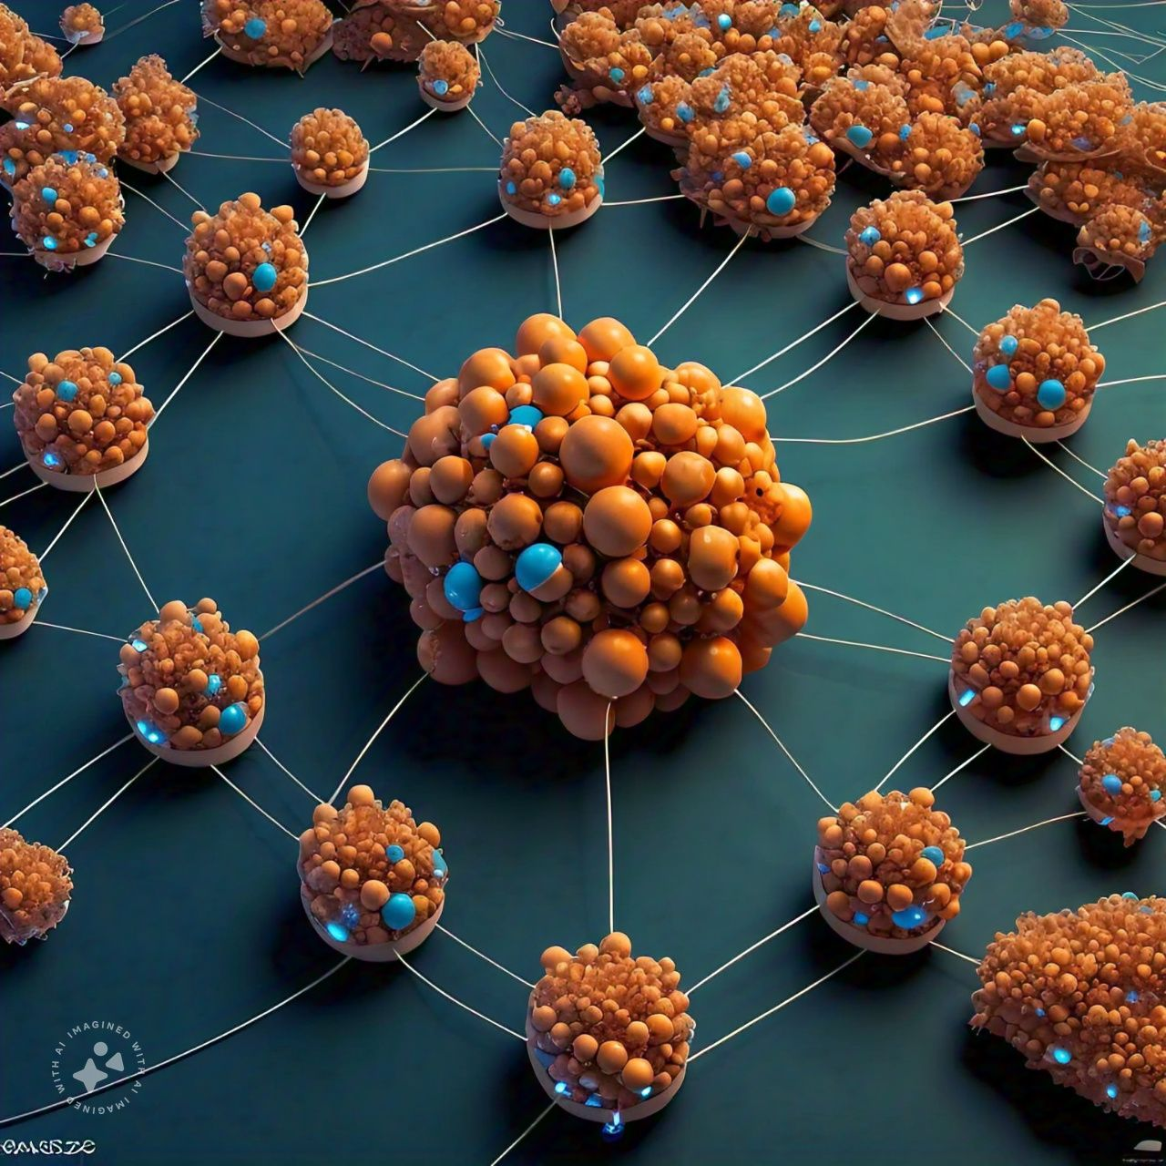
AFFINITY PROPAGATION
Number of Clusters
It is different from other clustering alorithms as it does not require to specify the number of clusters.

Slide 7
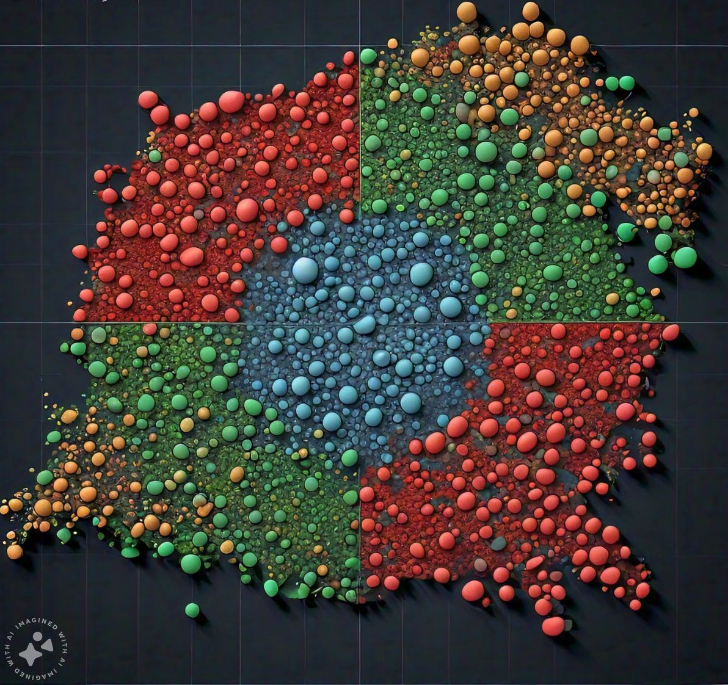
AFFINITY PROPAGATION
Similarity Data Clusters

Slide 8

AFFINITY PROPAGATION
Message Passing Clusters
In this, each data point sends a message between the pair of data points until convergence.

Slide 9
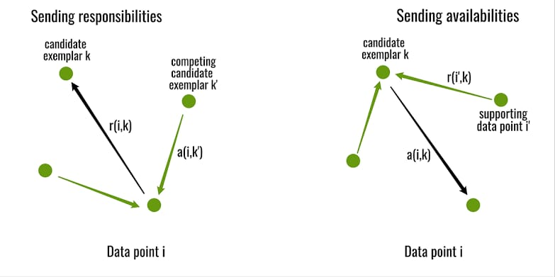
AFFINITY PROPAGATION
Responsibility Messages Availability Messages

Slide 10
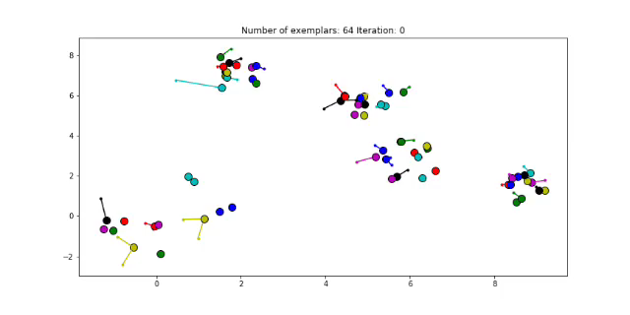
AFFINITY PROPAGATION

